Slide 1
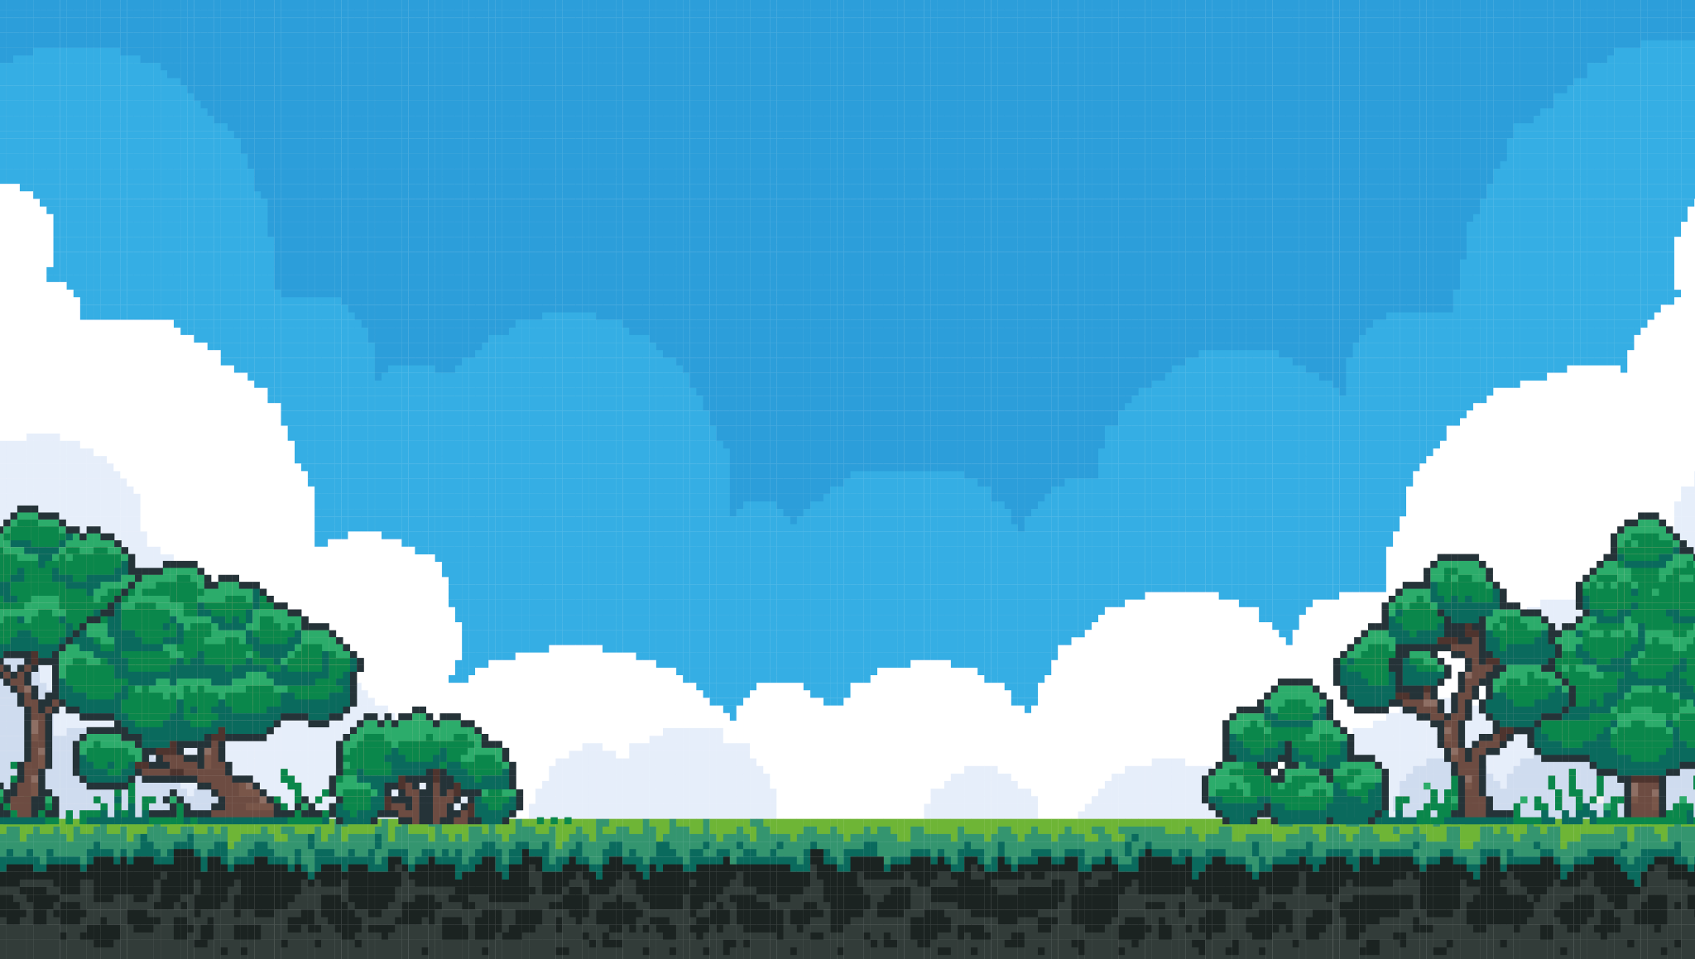
Quantity
Over
Quality
A Kubernetes Tale
By Alex Bissessur

Slide 2



Who Am I?
“I do fun things with
Kubernetes.”
Kubernetes and Cloud Native enthusiast
Organiser of Cloud Native Mauritius
Software Development intern at Swan
I like Python, Rust, and Linux
I have a small rack where I play with Kubernetes
Aspirations?
Play with Kubernetes for $$

Slide 3
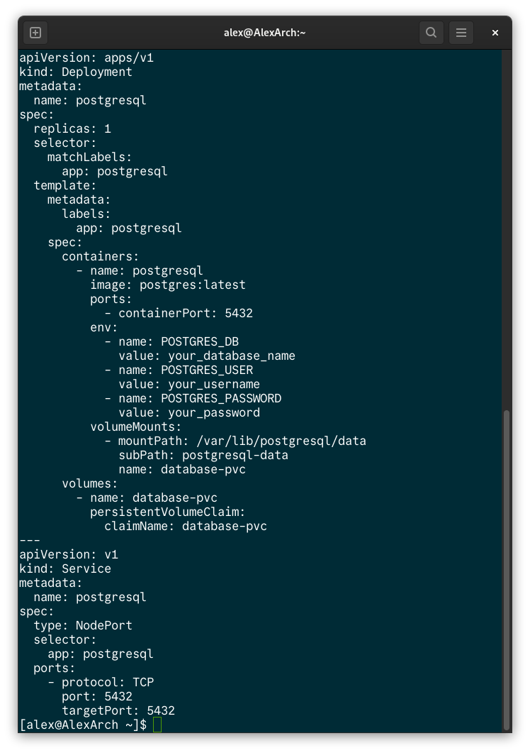
Kubernetes is easy?

Slide 4
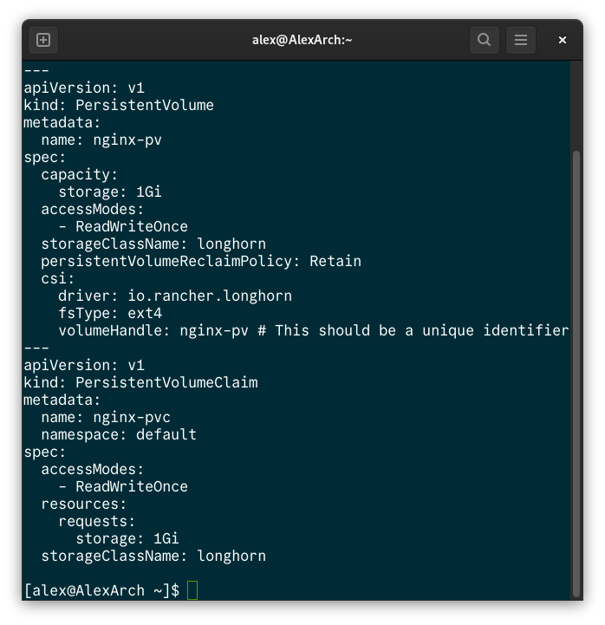
Kubernetes is easy?

Slide 5
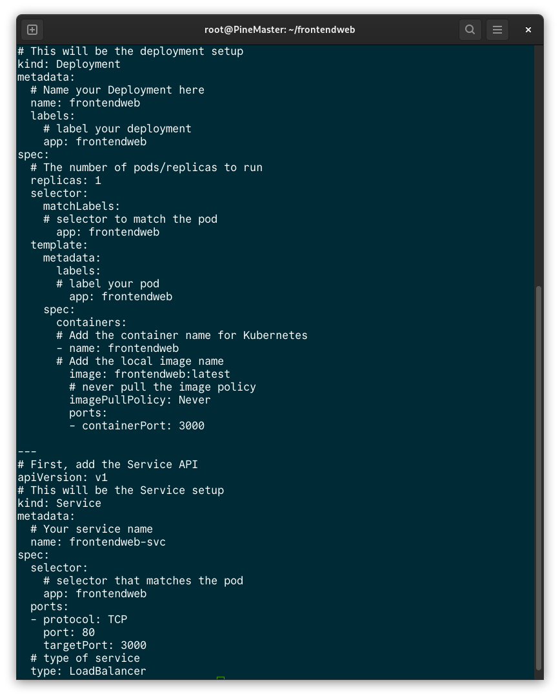
Kubernetes is easy?

Slide 6
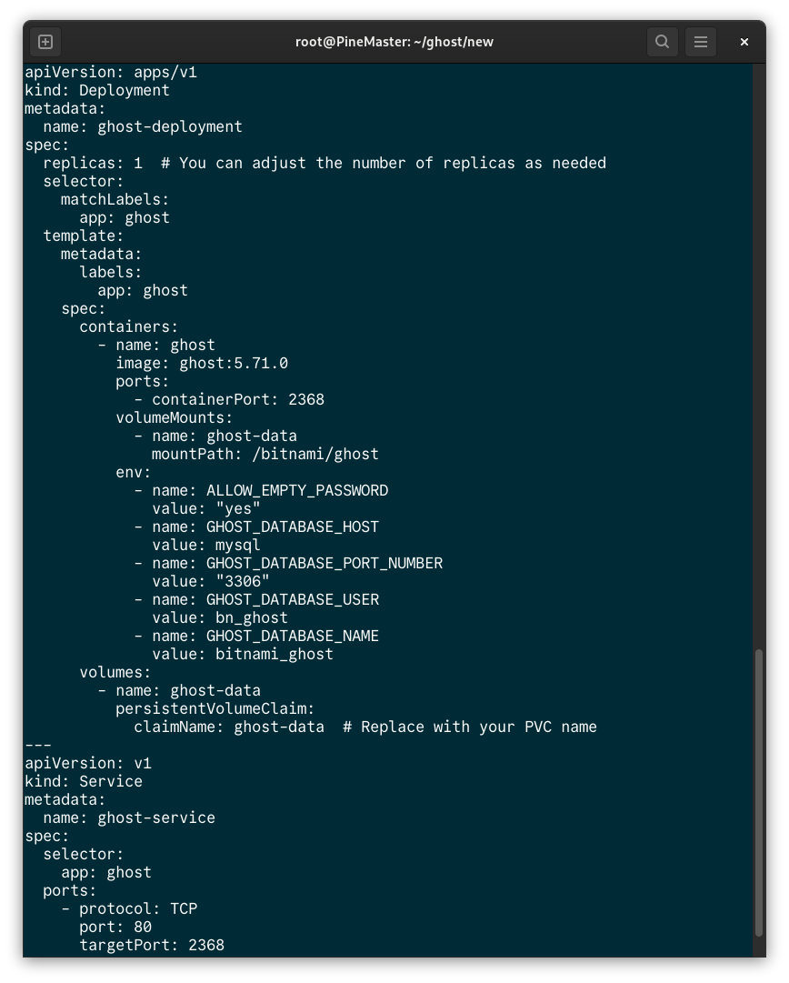
Kubernetes is easy?

Slide 7
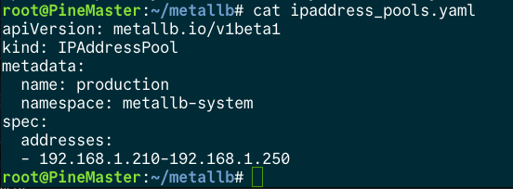
Kubernetes is easy?

Slide 8
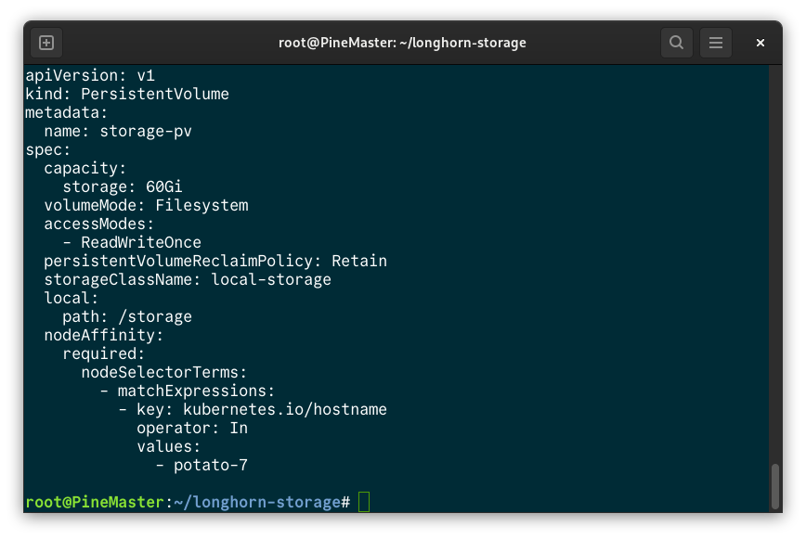
Kubernetes is easy?

Slide 9
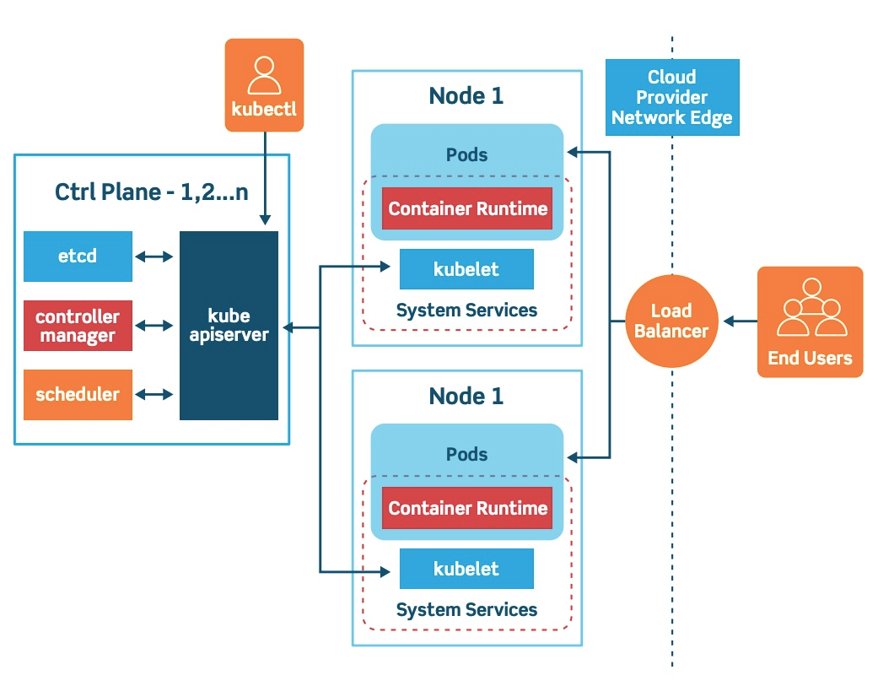
Kubernetes is simple?

Slide 10
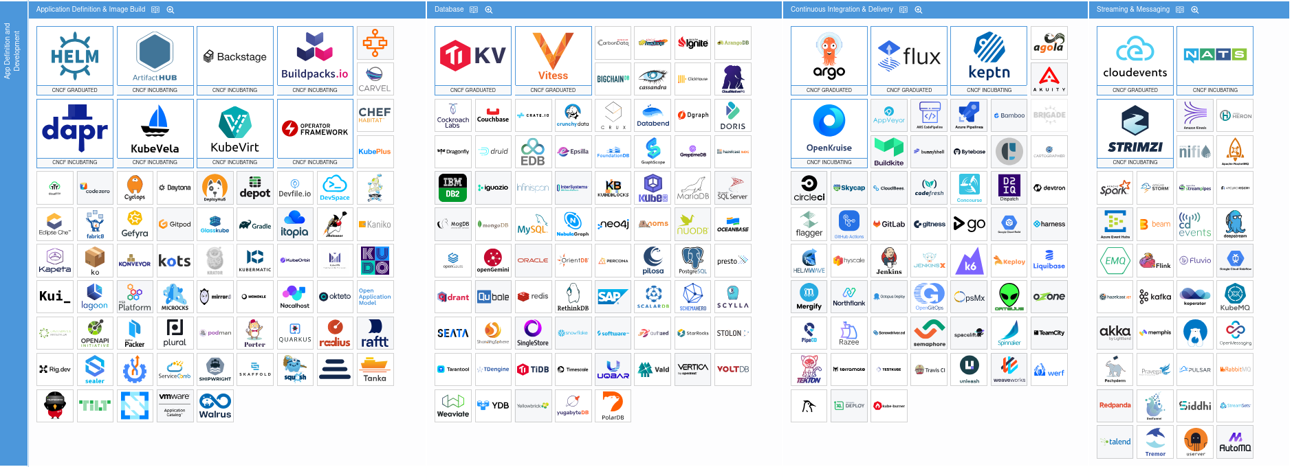
Kubernetes is straightforward?

Slide 11
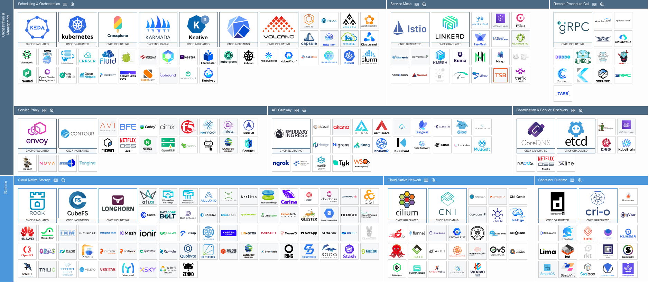
Kubernetes is straightforward?

Slide 12
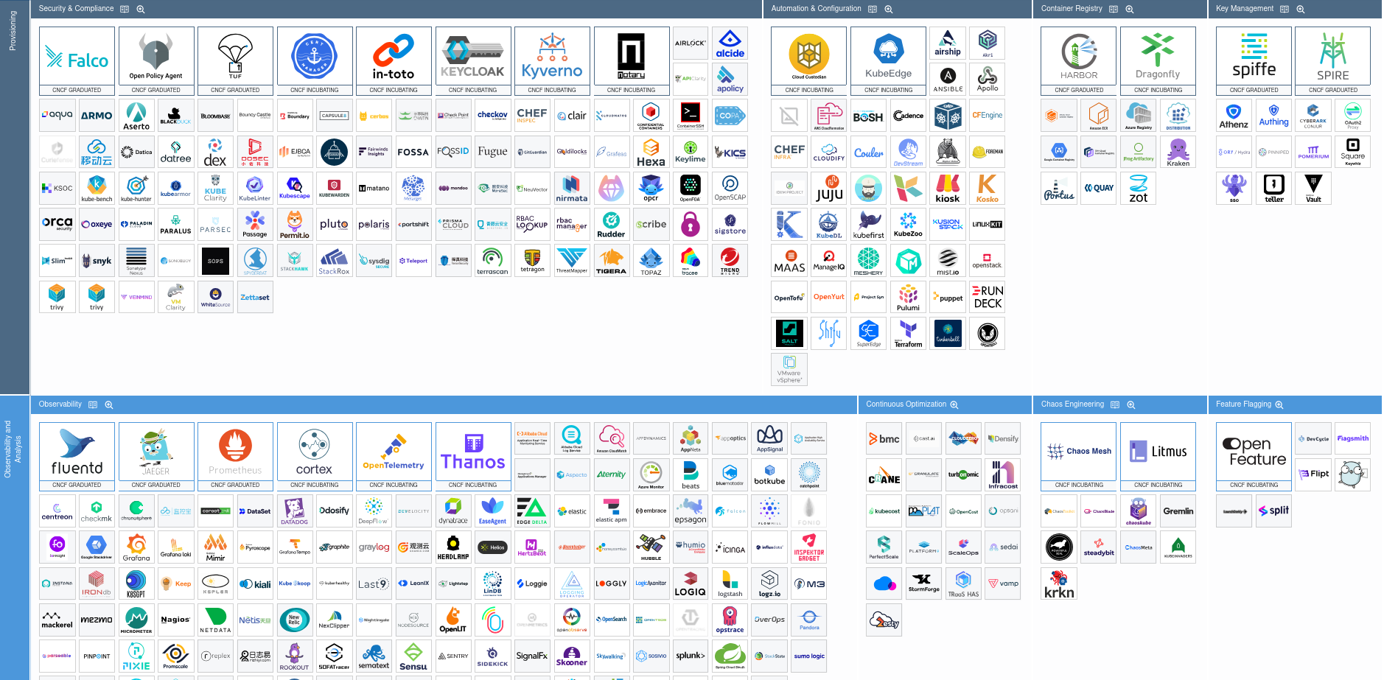
Kubernetes is straightforward?

Slide 13
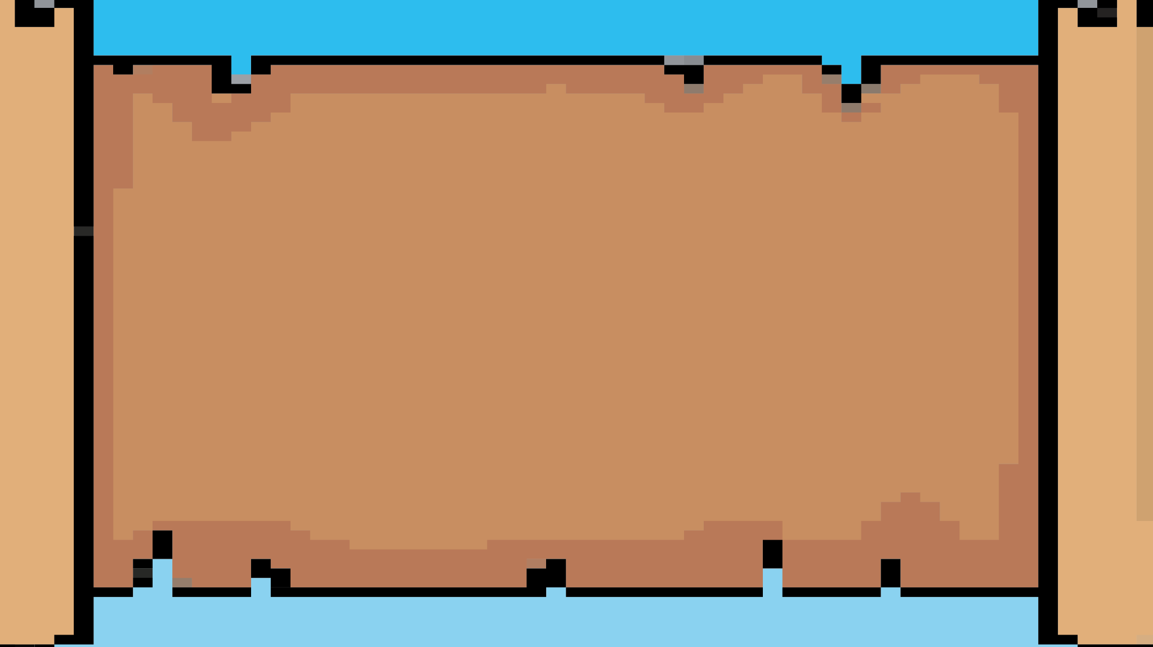
01.
01.
What is Kubernetes
02.
Kubernetes Components
03.
03.
Why you should use Kubernetes
04.
Smart Deployments for an easy life

Slide 14
What is Kubernetes?
“K8S is a system for automating deployment, scaling and management of containerised applications”
- Simply an abstraction/framework to run a cluster of computers
Industry standard with a whole ecosystem behind
Former Google product, now Open Source
Trademark held by Cloud Native Computing Foundation (Linux Foundation project)

Slide 15
Why is Kubernetes a Thing?
Born out of a need for cluster computing
“Previous” alternatives eg: Docker Swarm & Apache Hadoop
(I tried Swarm. It sucks.)
Offers more complex deployment than just “docker run”
Serves as platform for all other Cloud Native Apps

Slide 16
Kubernetes Components
nodes
pod
deployment
replicaset
service
persistent volume (claim)
namespace
and many more...

Slide 17
Pod
The smallest unit in Kubernetes
May contain 1 or more containers
Ephemeral – can be created, destroyed, and recreated dynamically
Does not have self-healing or scaling capabilities
Basically just runs a Docker container on your cluster

Slide 18
Deployment
Declarative updates for Pods and ReplicaSets
Ensures desired state is maintained (eg replicas)
Manages rollout of updates
Provides revision history for easy rollbacks
Allows setting update strategies
(RollingUpdate, Recreate, etc...)

Slide 19
Service
Networking solution in Kubernetes
Constant routes to variable pods
CoreDNS lets you use service name instead of IPs
Different types to regulate different traffic types
Supports load balancing
Fine grain control over traffic routing policies

Slide 20
Service
ClusterIP – communication inside cluster
uses: Constant routing within cluster
NodePort – exposing app through port on cluster nodes
uses: Exposing application through dedicated port
LoadBalancer – offered by CSPs
uses: Dedicated IP for application running on K8S

Slide 21
Persistent Volume (Claim)
Abstraction for persistent volume in Kubernetes
Deployments are stateless
- Restart container = drop tables
PV can be NFS, iSCSI, or even S3 compatible
PVC is an interface for PVs
PVC types
- Read (Only/Write) Many
- Read Write Once (Node/Pod)

Slide 22
Why Use Kubernetes
Single PC limited upgradeability
Expand horizontally not vertically
Quantity over quality
Redundancy
Exploiting microservices and containers
Better upgradeability, availability, portability

Slide 23
Building on Kubernetes
The power of Kubernetes is the CN Landscape
320 Cloud Native projects and counting
CI/CD
App Definition & Image Build
Databases
Streaming & Messaging
Scheduling & Orchestration
API Gateway
Discovery
Cloud Native Storage
Cloud Native Network
Service Mesg
Remote Procedure Call
Service Proxy
Chaos Engineering
Continuous Optimisation
Container Runtime
Security & Compliance
Container Registry
Automation & Configuration
Key Management
Observability
Feature Flagging
Coordination & Service

Slide 24
Physical Scaling
One server cannot be upgraded indefinitely
Physical limitations in compute power
Instead of 1 server, why not have 10?
Kubernetes unifies multiple servers
Kubernetes spreads pods across all nodes to best use resources

Slide 25
Virtual Scaling
Scaling microservices
Possible due to lack of state
Allows optimal use of resources
Scale up/down to accomodate demand
Horizontal Pod Autoscaler for hands-off scaling
Automatic load balancing of applications

Slide 26
Redundancy
1 server = 1 point of failure
Self-healing of deployments in case of failure
- Pods independent from nodes
- Services “follow” pods
Longhorn/Rook+Ceph allows distributed block storage for data redundancy
Multi-cloud cluster for added redundancy
Benefits physical upgrades or OS updates

Slide 27
Easy Management
Containerised means consistent between local, test & prod
GitOps and CI/CD pipelines for automatic deployment
No need to beg someone to deploy your app
apologies to my colleagues
Simpler scaling and resource management
- Can ensure my app doesn’t eat all the RAM

Slide 28
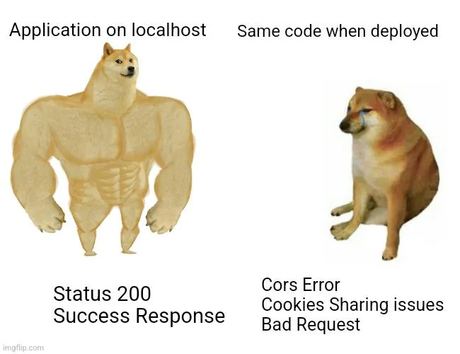
Easy Management

Slide 29
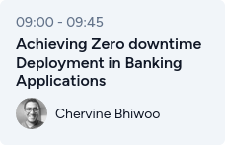
Fancy Deployment Strategies
Deployments can have different rollout strategies
Algorithms like Canary deployment, Rolling update
Blue/Green deployment concept
Detailed control over rollout to minimise customer impact

Slide 30
Rolling Update
Starts a new pod
Once new pod is running, takes down one old
Number upgraded at a time can be set
Works through all pods until they are all up to date
Traffic loadbalanced to both old & new pods

Slide 31
Canary Deployment
Initially deploy a small number of new pods
Gradually increase traffic to latest set
In case of errors, deployment automatically rolled back
Requires additional CN tools, such as ArgoCD, Istio or Linkerd

Slide 32
Blue-Green Deployment
2 environments created – Blue and Green
All traffic routed to Blue
Green group is upgraded and tested
Traffic rerouted to Green
Easy reroute back to Blue if Green has issues
Upgrade Blue in turn
0 downtime, consistent application for users

Slide 33
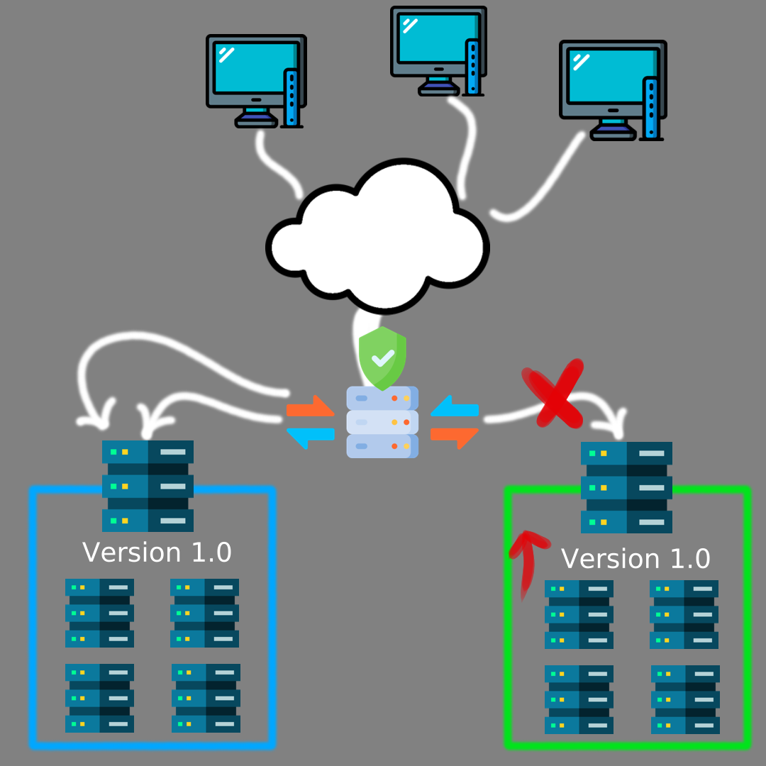
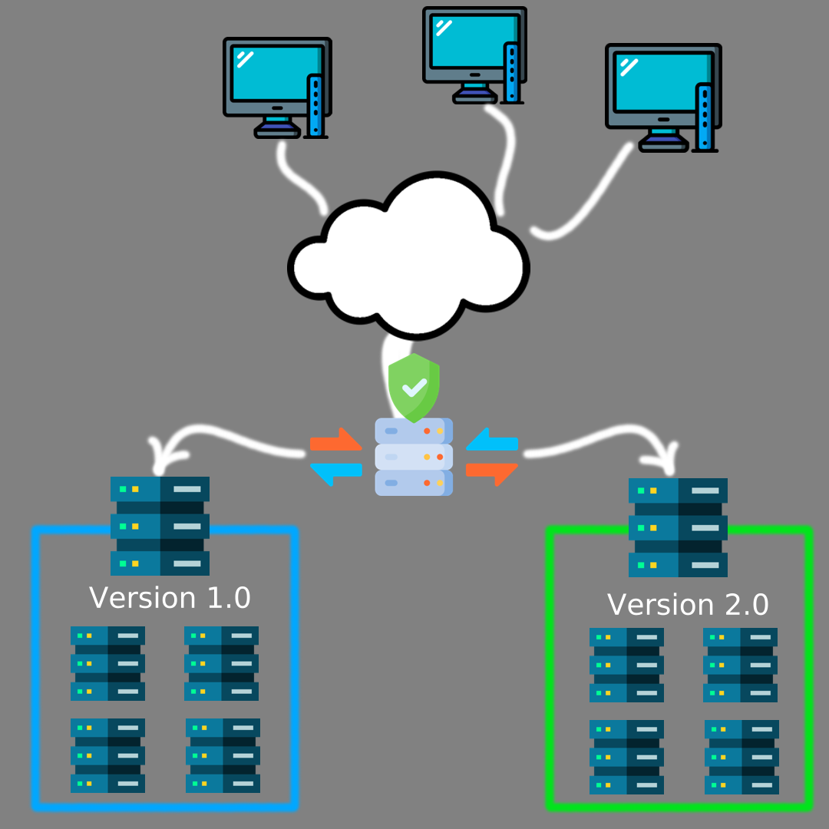
Blue-Green Deployment

Slide 34
Shadow Deployment
Create a new mirrored deployment
Traffic is mirrored to new version
Both versions process traffic
Only Old returns responses
Allows live testing with real world data
(now you can test on “prod”)

Slide 35
What’s not so cool about Kubernetes
Cost
Expertise
Keep it up to date
K8S has support for last 3 versions
Tool/plugin dependencies
Steep learning curve
Legacy monolith projects
Not cloud-optimised, lose out on cost benefits

Slide 36
Where to Learn More
Kubernetes is unavoidable. Embrace your new overlord.
Kubernetes Docs are great
Kodekloud courses, labs, and scenarios
Rancher Workshops (Rodeos)
Kubernetes Workshop (19th)
Linux for the Cloud Native Practitioner (19th)
Achieving Zero downtime Deployment in Banking Applications (20th)
SUSE talks for Linux/Containerisation

